Slide 1
Measuring the Quality of Life in Turkish Women Diagnosed with Polycystic Ovary Syndrome
Seher Haksever
Ayşe Filiz Gökmen Karasu

Slide 2
PLAN
What ıs Polycytic Ovary Syndrome(PCOS)?
PCOS symptoms and quality of life
Aim and Importance of Research
Material and Method
Results
Conslusion
References
CONCLUSIONCONCLUSION

Slide 3
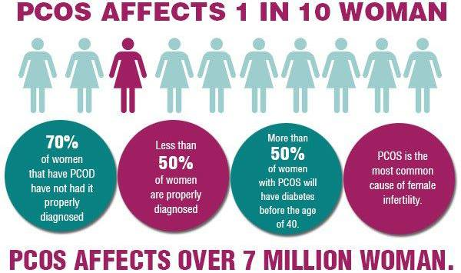
WHAT IS POLYCYSTIC OVARY SYDROME(PCOS)?
Polycystic Ovary Syndrome is an endocrine disorder affecting approximately 5-10% of women in the community. It is also the most common endocrinopathy in women in the reproductive period. It is a complex, heterogeneous, multifactorial disease that may adversely affect the quality of life in the future, which may occur due to disruption of the interactions between the central nervous system, pituitary, ovaries, adrenal glands and extraglandular tissues

Slide 4
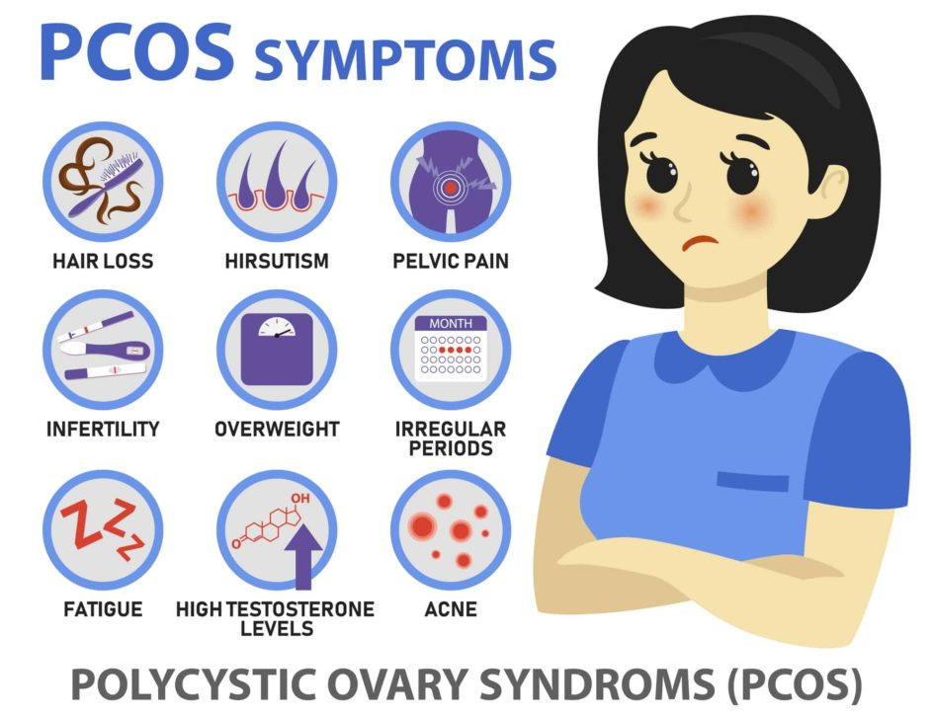
PCOS is a “syndrome,” or group of symptoms that affects the ovaries and ovulation. Its three main features are:
cysts in the ovaries
high levels of androjen levels
irregular or skipped menstrual periods
PCOS is related with some clinic complications as reproductive(menstural irregularities, infertility), metabolic (insulin resistance, DM, cardiyovascular risks) and phsycolocigal disabilities (anxiety, depression). It has been stated that all of these conditions are the cause of the significant decline in the quality of life of patients in more than one study and meta-analysis

Slide 5
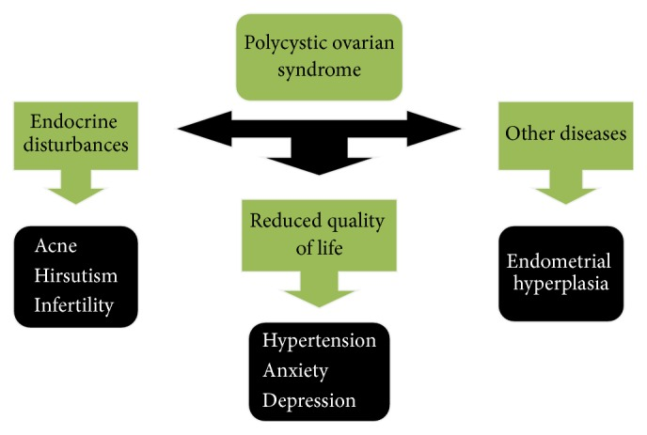
In the literature, there are studies about the quality of life of patients with PCOS using disease-specific or general scales. Although it has been shown in the literature that different markers affect the quality of life at different rates, there is no study in our country using the PCOSQ-50 scale developed specifically for PCOS. The aim of our study is to evaluate the quality of life of women diagnosed with PCOS at Bezmialem Vakıf University Medical Faculty Hospital.

Slide 6
MATERIALS AND METHODS
147 patients who were diagnosed with PCOS and whose treatment was planned were included in the study. The PCOSQ-50 (Polycystic Ovary Syndrome Questionnaire-50) questionnaire was used to measure the quality of life of the patients

Slide 7
This scale consists of six parameters: psychosocial and emotional , fertility, sexual function, obesity/menstrual disorders,hirsutizm disorder and coping. It consists of 50 questions.

Slide 8
RESULTS
 | Mean±sd
Height(cm) | 164.03±5.45
Weight (kg) | 62.72±12.130
Disease Duration (month) | 25.29±24.787
First Time of Period(year) | 12.99±1.891

Slide 9
The most common symptom was hirsutizm, while the least common symptom was infertility
Out of 147 people participating in the study, 39 were found married, 106 were single, and 2 were divorced. When compared according to marriage status, a significant difference was found in the fertility sub-section (p = 0.0074).
When we compare people having children and have no children, significant differences were found between the two groups in the sub-sections of psychosocial (p = 0.024), fertility (p = 0.07), and hursitizm (p = 0.034).

Slide 10
Psychosocial and Emotional | Fertility | Sexual Function | Obesity and Menstrual Disorders | Hirsutizm | Coping Skill
40.7755±9.4 | 30.8163±4.6 | 36.3816±7.4 | 29.775±9.102 | 19,9524±7.4 | 26.7347±5.94
The higher score represents better function

Slide 11
When compared according to the symptoms present in patients ;
Hirsutizm
Infertility
 | present | absent | P value
Psychosocial and emotional | 39,0011±8.4* | 43,5614±10,26439* | 0,004
Fertility | 33(15-35)** | 31(15-35) ** | 0,010
Sexual Function | 36(45-21)** | 36(17-45) ** | 0,657
Obesity and menstrual disorders | 29(9-45) ** | 31(12-46) ** | 0,737
Hirsutizm | 17(6-30)** | 27(8-35) ** | <0.001
Coping | 27(8-35) ** | 30(8-35) ** | 0,017
 | present | absent | P value
Psychosocial and emotional | 40,6667±8,697* | 40,78001±9,47786* | 0,977
Fertility | 27(15-32) ** | 33(15-35) ** | 0,005
Sexual Function | 24(17-45) ** | 36(21-45) ** | 0,349
Obesity and menstrual disorders | 27,5(15-36) ** | 30(9-46) ** | 0,339
Hirsutizm | 23.5(10-30) ** | 20(6-30) ** | 0,486
Coping | 28.5(17-45) ** | 27(8-35) ** | 0,713
*T-test
* * Mann-Whitney U
*T-test
* * Mann-Whitney U

Slide 12
Menstrual Disorder
 | present | absent | P value
Psychosocial and emotional | 39,72±9,26* | 43,0213±9.48* | 0,047
Fertility | 32(15-35)** | 33(20-35)** | 0,048
Sexual Function | 36(21-45)** | 37(17-45) ** | 0,529
Obesity and menstrual disorders | 34(15-45) ** | 26(9-46) ** | <0,001
Hirsutizm | 20(6-30) ** | 22(6-30) ** | 0,133
Coping | 27(14-35) ** | 27(14-35) ** | 0,659
*T-test
* * Mann-Whitney U

Slide 13
CONCLUSION
PCOS can disrupt the menstrual cycle, leading to fewer periods. Acne, hair growth, weight gain, and dark skin patches are other symptoms of the condition.
The findings indicated that quality of life impairment in women with PCOS was associated with hirsutism, infertility and menstrual irregularity. Indeed appropriate management strategies are needed to improve quality of life in these women

Slide 14
REFERENCES
1. Fauser BCJM, Tarlatzis BC, Rebar RW, Legro RS, Balen AH, Lobo R, et al. Consensus on women’s health aspects of polycystic ovary syndrome (PCOS): The Amsterdam ESHRE/ASRM-Sponsored 3rd PCOS Consensus Workshop Group. In: Fertility and Sterility. 2012.
2. Teede H, Deeks A, Moran L. Polycystic ovary syndrome: A complex condition with psychological, reproductive and metabolic manifestations that impacts on health across the lifespan. Vol. 8, BMC Medicine. 2010.
3. Rothenberg SS, Beverley R, Barnard E, Baradaran-Shoraka M, Sanfilippo JS. Polycystic ovary syndrome in adolescents. Vol. 48, Best Practice and Research: Clinical Obstetrics and Gynaecology. 2018. p. 103–14.
4. Puurunen J, Piltonen T, Morin-Papunen L, Perheentupa A, Järvelä I, Ruokonen A, et al. Unfavorable hormonal, metabolic, and inflammatory alterations persist after menopause in women with PCOS. J Clin Endocrinol Metab. 2011;96(6):1827–34.
5. Balikci A, Erdem M, Keskin U, Bozkurt Zincir S, Gülsün M, Özçelik F, et al. Polikistik over sendromu olan hastalarda depresyon, anksiyete ve Öfke. Noropsikiyatri Ars. 2014;51(4):328–33.
6. Basirat Z, Faramarzi M, Esmaelzadeh S, Firoozjai SA, Mahouti T, Geraili Z. Stress, depression, sexual function, and alexithymia in infertile females with and without polycystic ovary syndrome: A case-control study. Int J Fertil Steril. 2019;13(3):203–8.
7. Jones GL, Hall JM, Balen AH, Ledger WL. Health-related quality of life measurement in women with polycystic ovary syndrome: A systematic review. Vol. 14, Human Reproduction Update. 2008. p. 15–25.
8. Panico A, Messina G, Lupoli GA, Lupoli R, Cacciapuoti M, Moscatelli F, et al. Quality of life in overweight (Obese) and normal-weight women with polycystic ovary syndrome. Patient Prefer Adherence. 2017;11:423–9.
9. Bazarganipour F, Taghavi SA, Montazeri A, Ahmadi F, Chaman R, Khosravi A. The impact of polycystic ovary syndrome on the health-related quality of life: A systematic review and meta-analysis. Iran J Reprod Med. 2015;13(2):61–70.
10. McCook JG, Reame NE, Thatcher SS. Health-related quality of life issues in women with polycystic ovary syndrome. JOGNN - J Obstet Gynecol Neonatal Nurs. 2005;34(1):12–20.
11. Behboodi Moghadam Z, Fereidooni B, Saffari M, Montazeri A. Polycystic ovary syndrome and its impact on Iranian women’s quality of life: A population-based study. BMC Womens Health. 2018;18(1).
12. KOYUTÜRK G. POLİKİSTİK OVER SENDROMU YAŞAM KALİTESİ-50 ÖLÇEĞİ’NİN TÜRKÇE UYARLAMASININ GEÇERLİK VE GÜVENİRLİĞİ.

